Slide 1
STM32 보드를 사용한 간단한 선풍기
경기인력개발원
최명수

Slide 2
목표
선풍기 세기 조절
STM32 보드의 timer를 사용한 PWM 생성
버튼 상태 읽기
선풍기 상태 표시
- LED & LCD 제어

Slide 3
State Machine Diagram
Stopped
Speed 1
LCD displays “Stopped”
Press Button 1
LED 1 lights up
LCD displays “speed 1”
fan activates at speed 1
Press Button 0
Press Button 3
Press Button 0
Press Button 2
Press Button 1
Press Button 1
Press Button 2
Press Button 3
Press Button 0
Speed 3
Speed 2
LED 3 lights up
LCD displays “speed 3”
fan activates at speed 3
LED 2 lights up
LCD displays “speed 2”
fan activates at speed 2
Press Button 2
Press Button 3

Slide 4
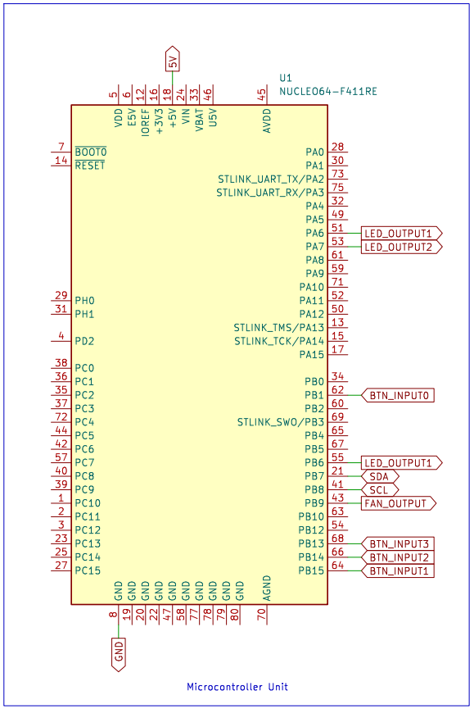
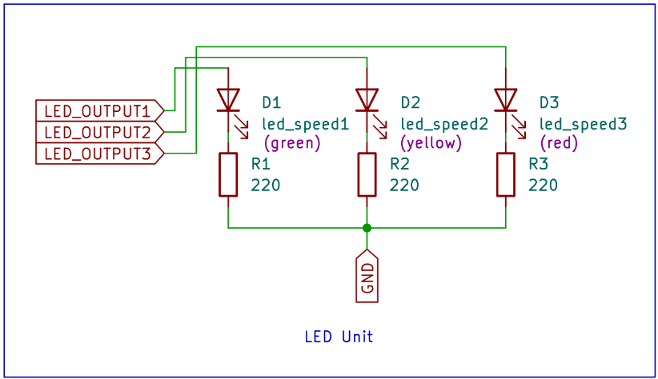
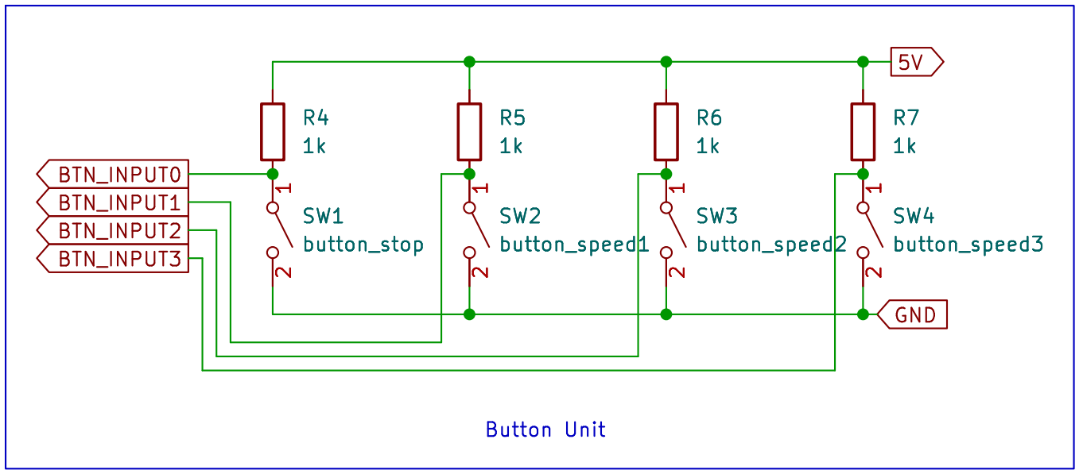
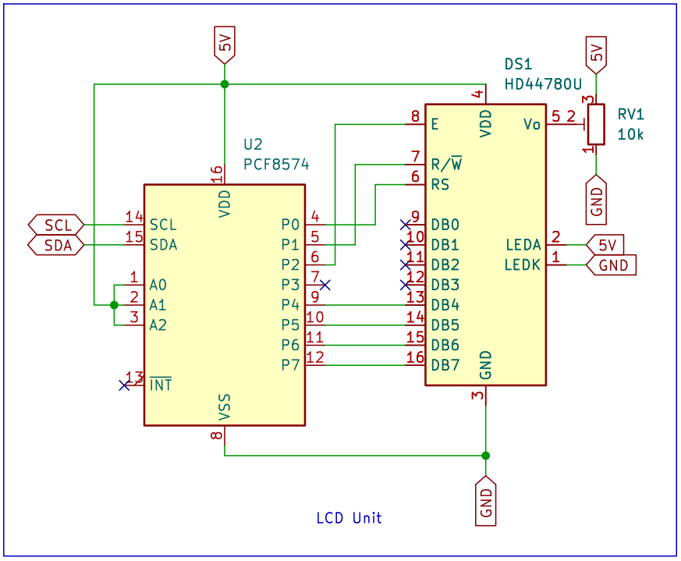
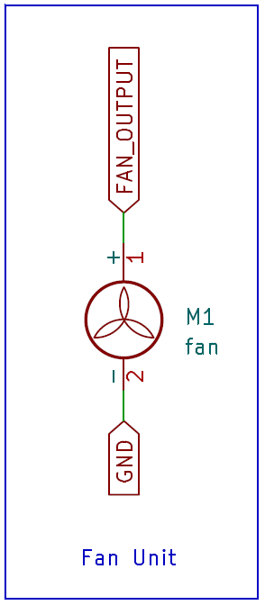
회로도

Slide 5
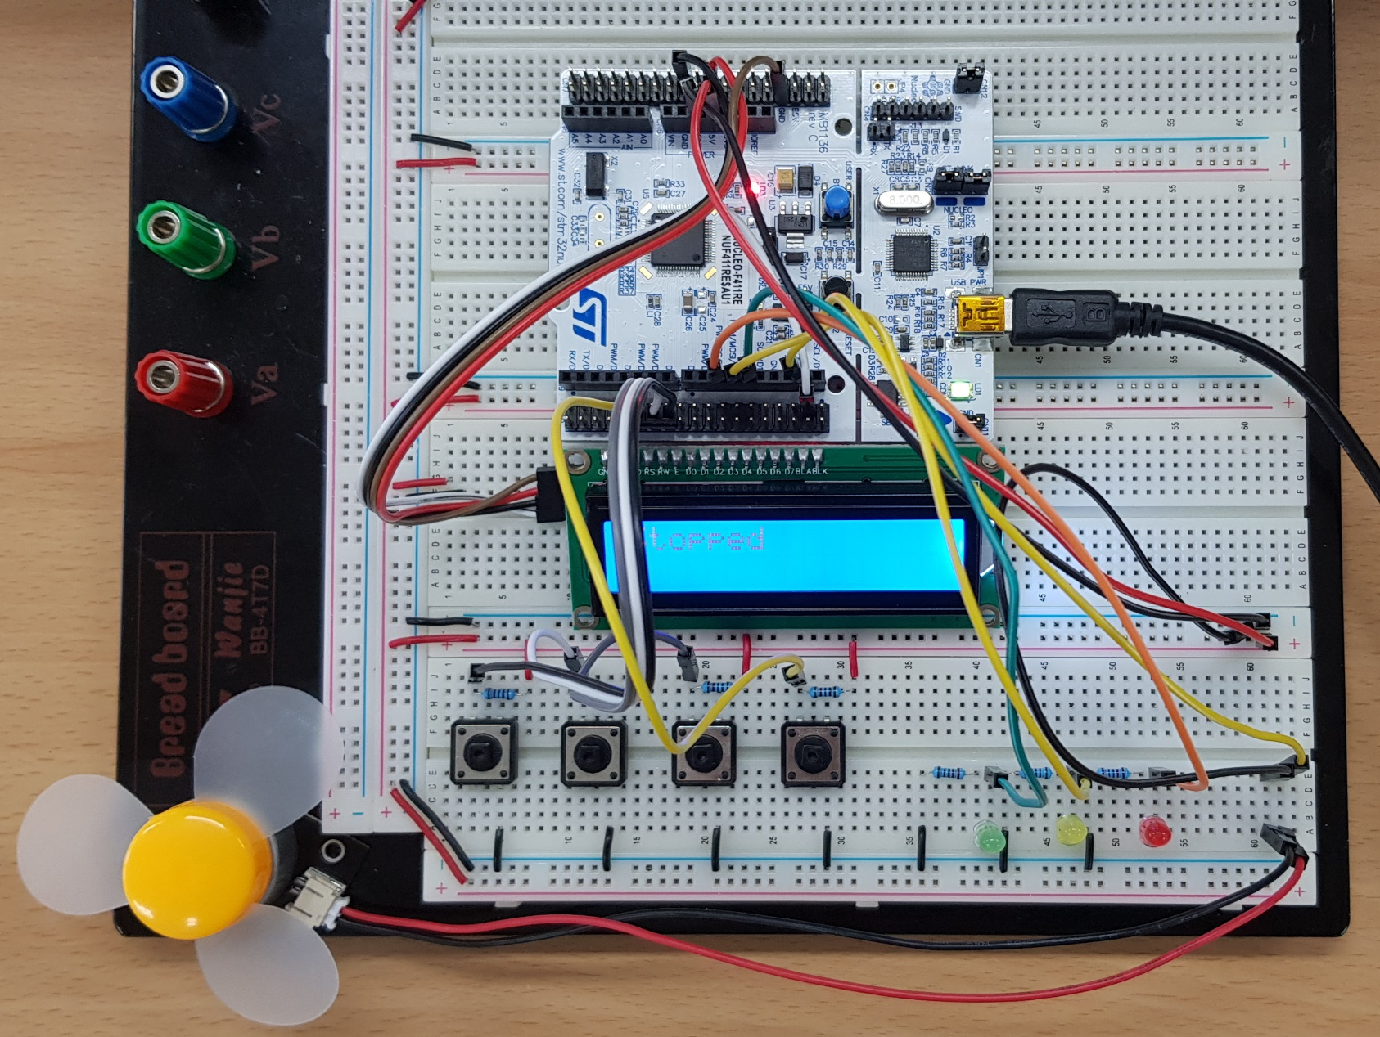
회로도 구현

Slide 6
Code Summary
main()
①
Button/LED/Fan 구조체
선언 및 초기화
③
led.h/led.c
④
lcd.h/lcd.c
while (1)
⑤
button.h/button.c
②
버튼 입력 확인 후
대응되는 명령들 실행
⑥
fan.h/fan.c

Slide 7
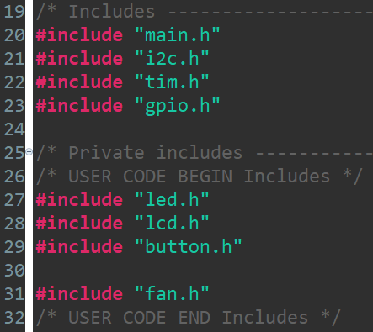
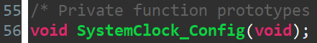
Code ⓪ - Before main()
Line | Comment
20 | For HAL functions
21-23 | For handlers and initialization functions
56 | Set system clock as 100MHz using embedded 8MHz crystal oscillator

Slide 8
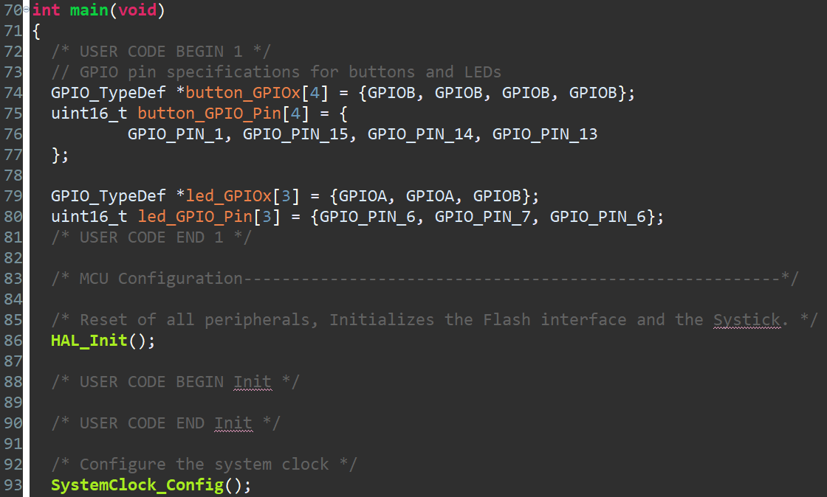
Code ① - 1

Slide 9
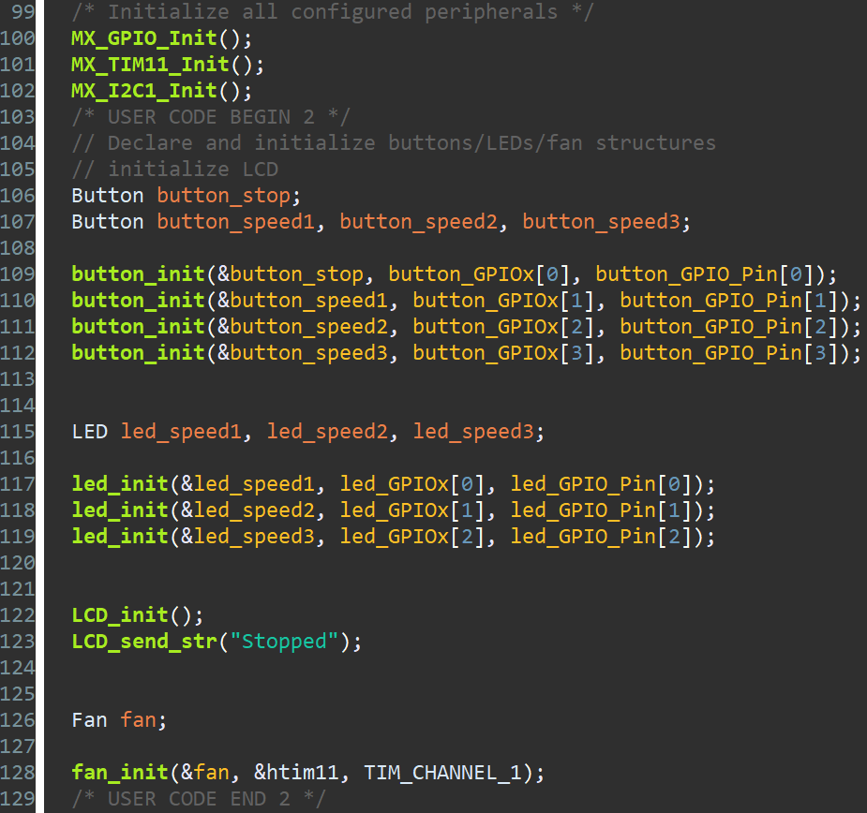
Code ① - 2
Line | Comment
100 | Configure General Purpose Input/Output(GPIO) pins PB1, PB13, PB14, PB15 as input pins for buttons PA6, PA7, PB6 as output pins for LEDs
101 | Configure I2C to fit the specification of remote 8-bit I/O expander(PCF8574) attatched to the LCD(HD44780U)
102 | Initialize a timer for the PWM generation

Slide 10
Code ① - 3

Slide 11
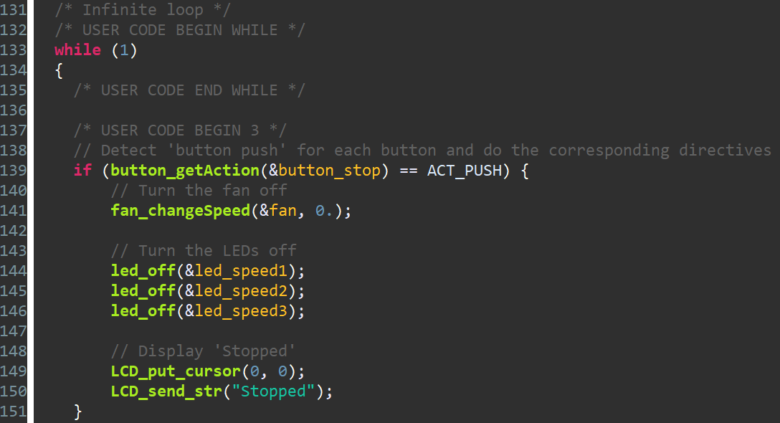
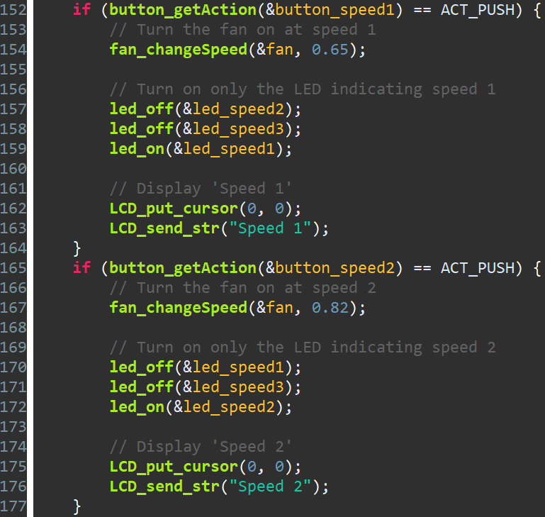
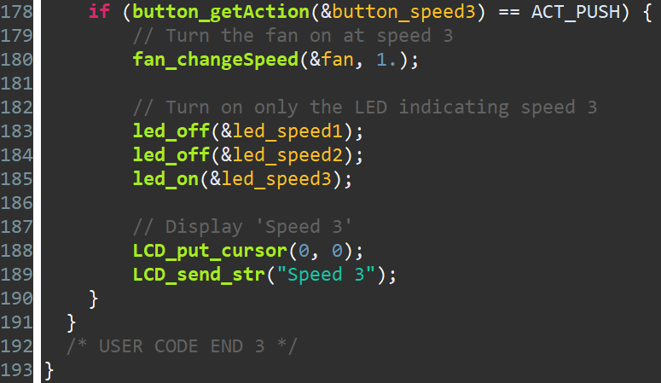
Code ②

Slide 12
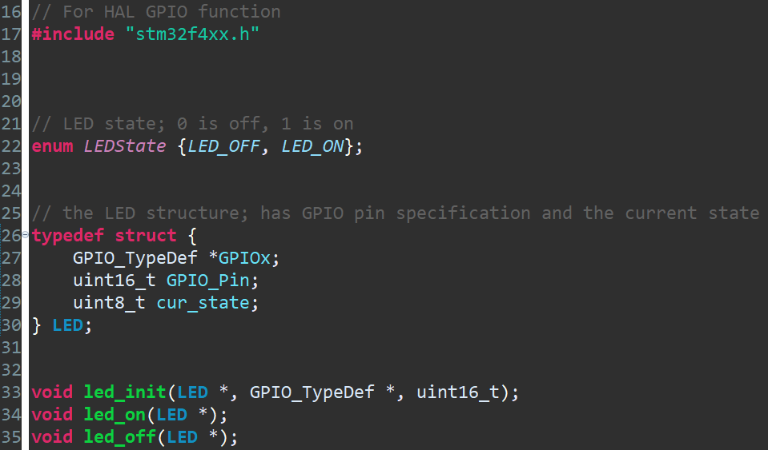
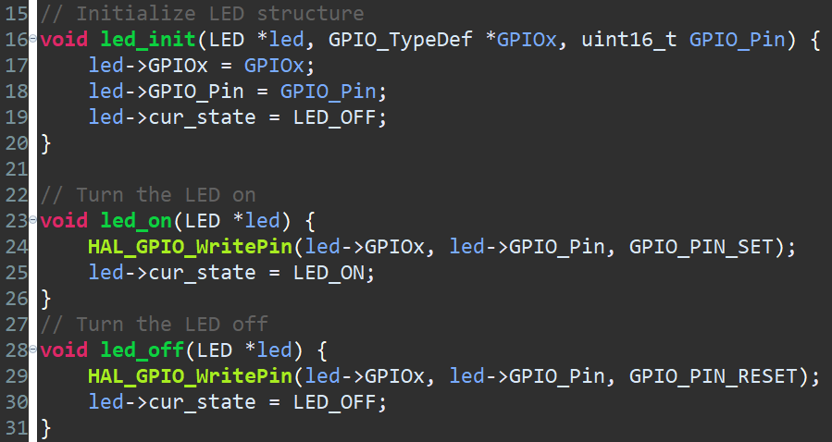
Code ③ - led.h / led.c

Slide 13
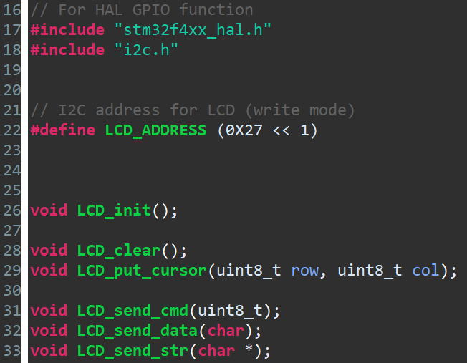
Code ④ - lcd.h

Slide 14
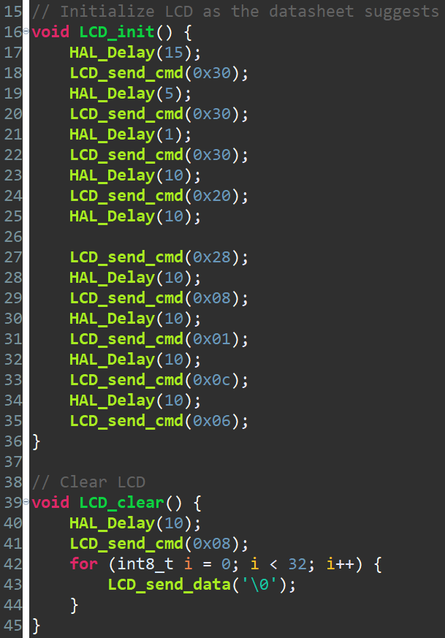
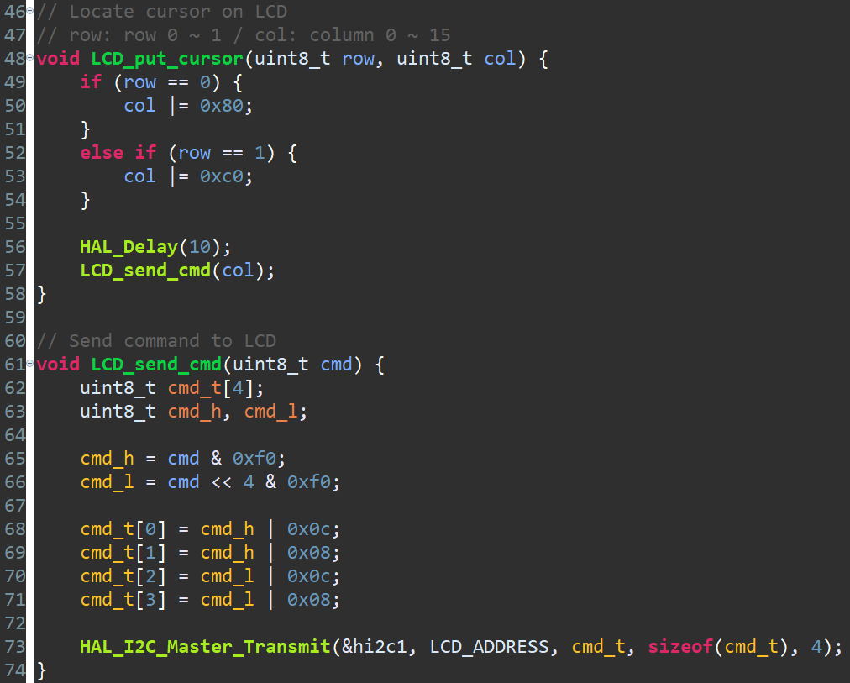
Code ④ - lcd.c 1

Slide 15
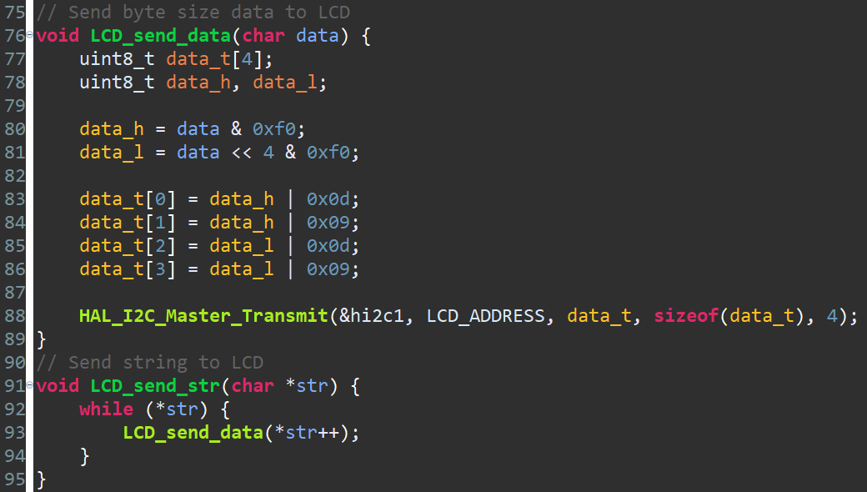
Code ④ - lcd.c 2

Slide 16
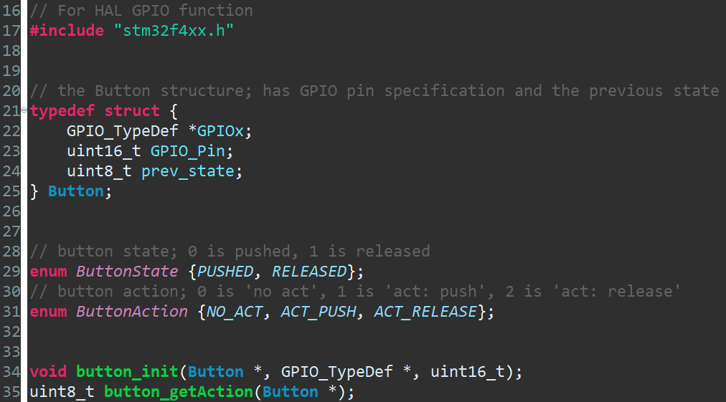
Code ⑤ - button.h

Slide 17
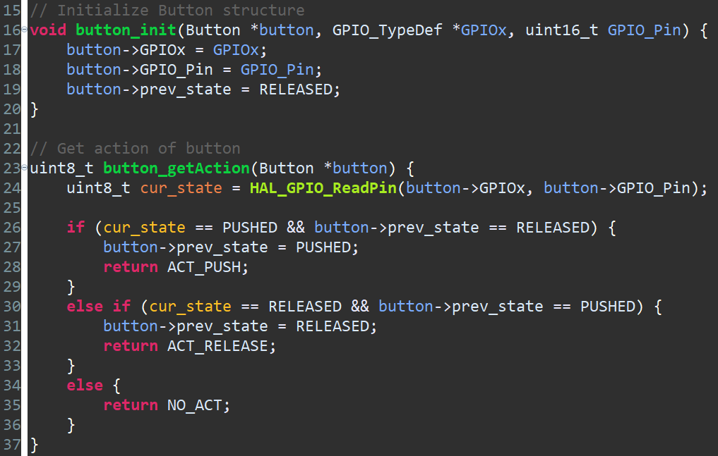
Code ⑤ - button.c

Slide 18
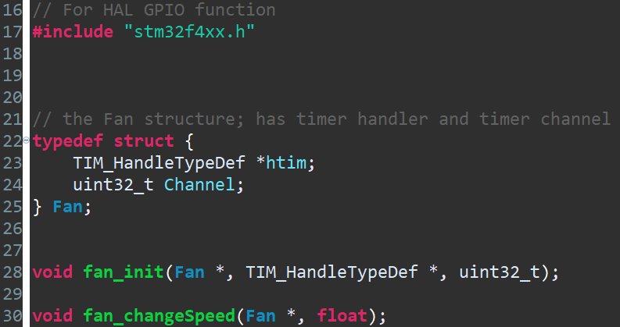
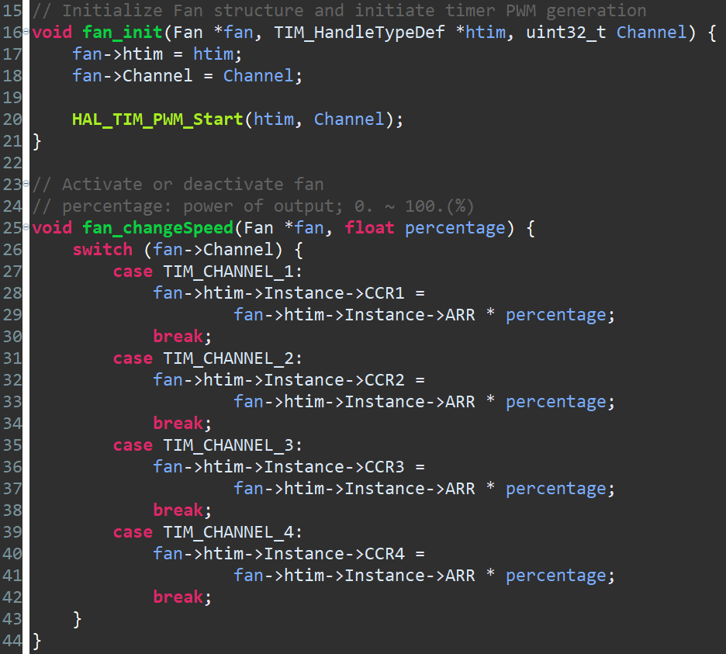
Code ⑥ - fan.h

Slide 19
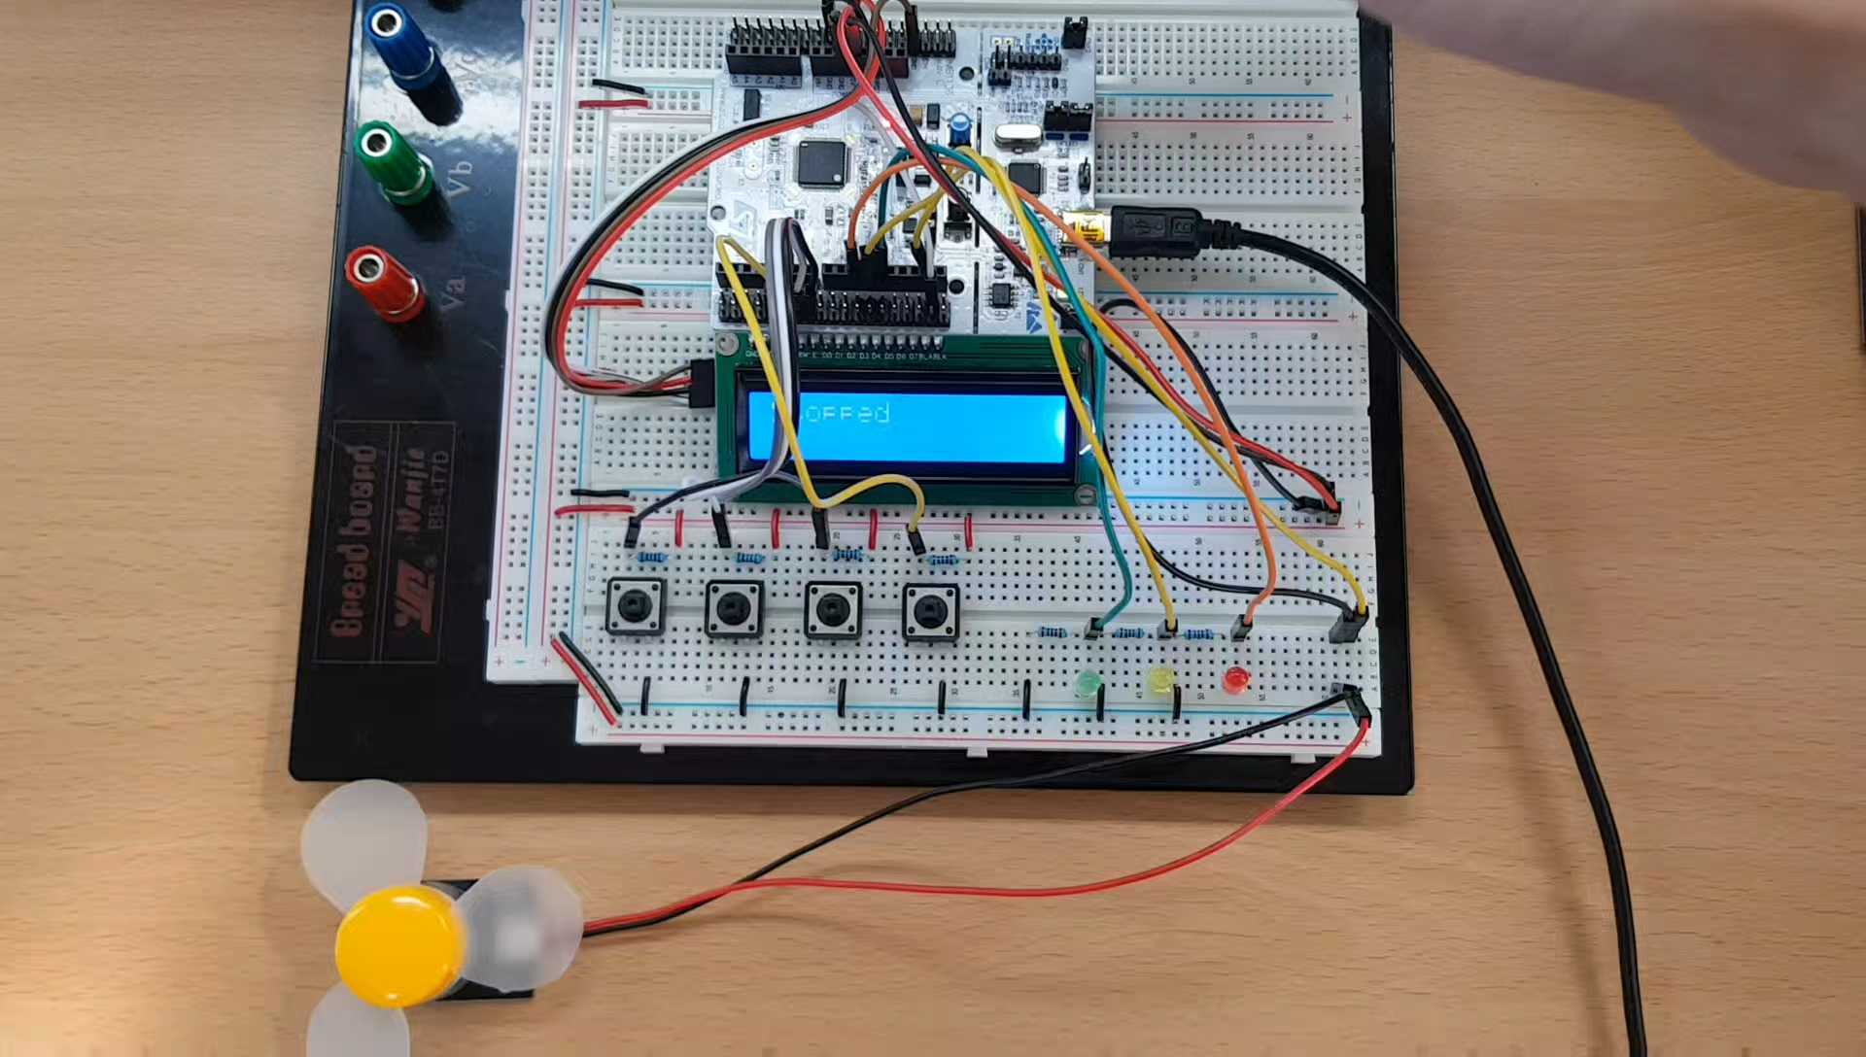
작동 영상

